Slide 1
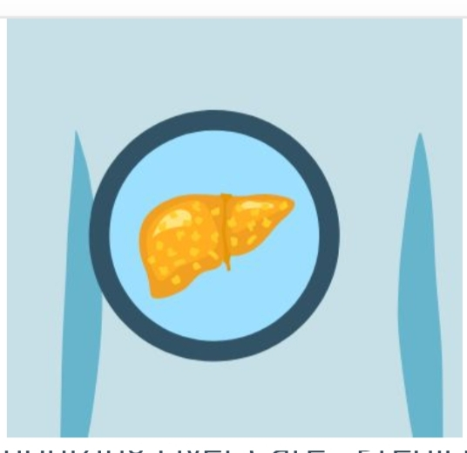
Revolutionizing Liver Care : Predicting Liver Cirrhosis Using Advanced Machine Learning Techniques
Presented by:
1. Vangeti Asrutha
2. SaNaka eswer datha
3. Vanitha orsu
4. Thulimelli Srikanth
Team id:LTVIP2025TMID40349

Slide 2
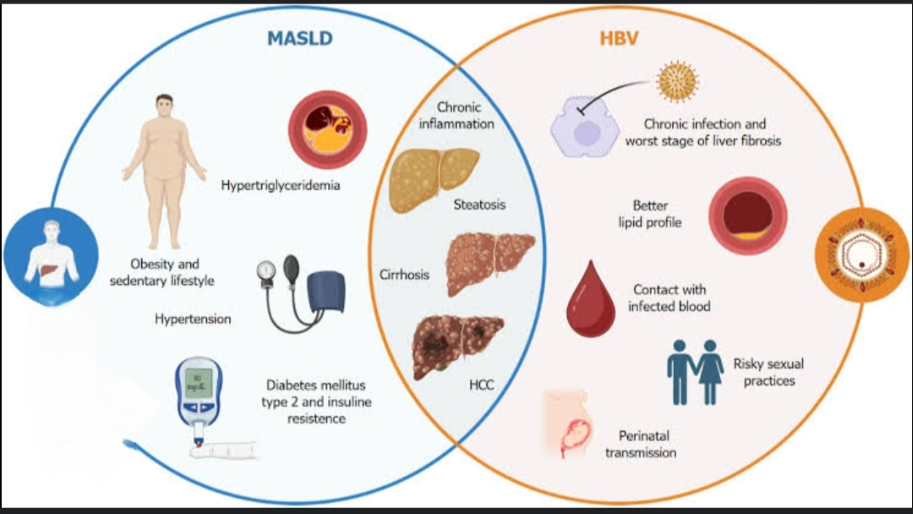
Introduction to Revolutionizing liver:
The intersection between metabolic-associated steatotic liver disease (MASLD) and chronic hepatitis B virus (HBV) infection is an emerging area of research with significant implications for public health and clinical practice. Wang et al’s study highlights the complexities of managing patients with concurrent MASLD and HBV. The findings revealed that patients with concurrent MASLD-HBV exhibited more severe liver inflammation and fibrosis, whereas those with HBV alone presented a better lipid profile

Slide 3
Milestone 1: Define Problem / Problem Understanding
focuses on thoroughly understanding the issue at hand before attempting to solve it. This involves clearly identifying the problem, its scope, and its impact, as well as gathering relevant data and involving stakeholders.
Key aspects of Milestone 1:
Problem Definition:
Clearly articulate the problem. What is the deviation from the desired state? What are the symptoms? What are the boundaries of the problem?
Business Understanding:
Research and understand the business context, including its goals, processes,

Slide 4

Milestone 2: Data Collection & Preparation
Milestone 2, focused on Data Collection and Preparation, involves gathering the necessary data for your project, understanding its structure, cleaning and preprocessing it, and then analyzing it to gain initial insights. This milestone is crucial for building a solid foundation for your project, ensuring the data is accurate and ready for further analysis and modeling.
Here's a breakdown of the key tasks involved:
Data Acquisition:
Identify relevant data sources:
Determine where your data will come from (e.g., public datasets, APIs, surveys, existing databases).
Collect the data:
Gather the data from the identified sources, ensuring you have the necessary permissions and access.

Slide 5
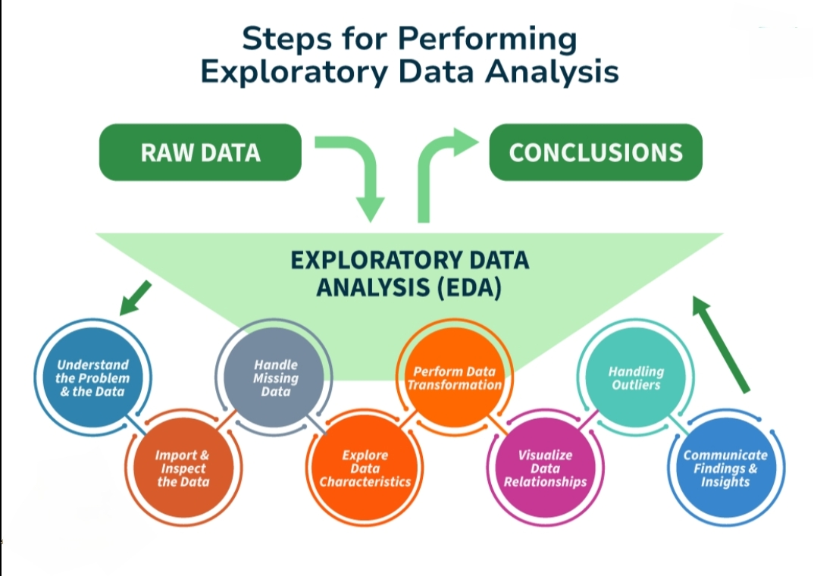
Milestone 3: Exploratory Data Analysis
Milestone 3, Exploratory Data Analysis (EDA), involves examining your dataset to understand its characteristics, identify patterns, and uncover potential issues before formal analysis or modeling. This stage is crucial for gaining insights, formulating hypotheses, and preparing data for subsequent steps.
Key aspects of EDA include:
Data Understanding: Familiarize yourself with the data's structure, variables, and potential relationships.
Data Cleaning: Address missing values, duplicates, and data type inconsistencies.
Univariate Analysis: Analyze individual variables using summary statistics (mean

Slide 6
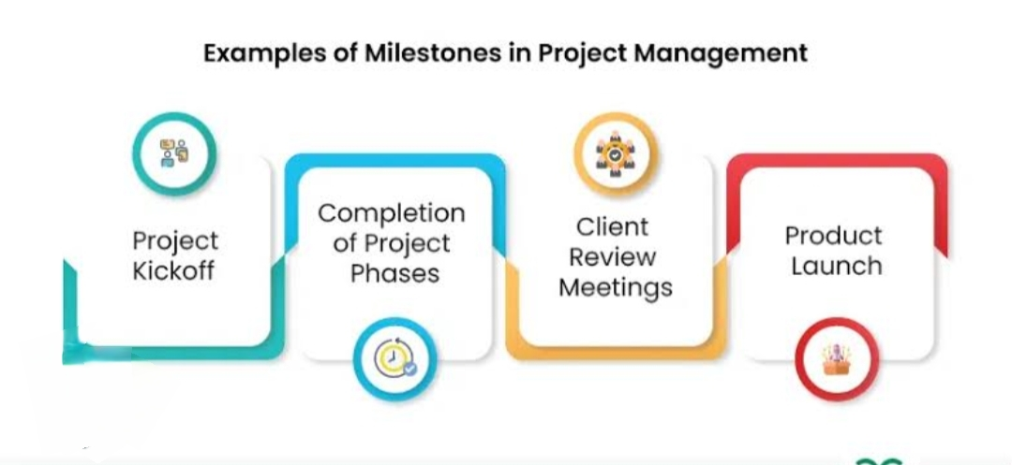
Milestone 4: Model Building
"Model Building," signifies the stage where the actual construction or development of the project's core components begins, often following a period of design and planning. It involves creating, testing, and refining the key elements of the project based on the established specifications. This could involve building software, physical prototypes, or other project-specific models.
Key Aspects of Milestone 4 (Model Building):
Construction:
This is where the project starts to take physical or digital shape. It could involve coding a software application, assembling a product, or constructing a building.
Testing and Refinement:
As the model is built, it's crucial to test its functionality and identify areas for

Slide 7
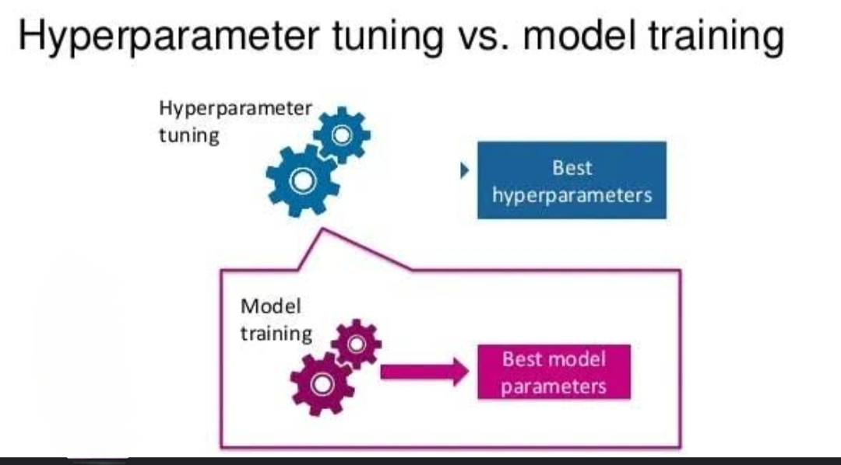
Milestone 5: Performance Testing & Hyperparameter Tuning
This involves evaluating the model's performance using various metrics and then iteratively adjusting hyperparameters to improve its effectiveness. The goal is to find the optimal configuration of hyperparameters that maximizes the model's performance, typically measured by a chosen metric like accuracy or F1-score.
Here's a breakdown of the key concepts:
1. Performance Testing:
Purpose:
To assess how well the model performs on unseen data and identify areas for improvement.
Metrics:
Common metrics include accuracy, precision, recall, F1-score, AUC-ROC, and others depending on the specific task (classification, regression, etc.).
Tools:
Confusion matrices are used to visualize and analyze the performance of classification models.
Process:
Involves evaluating the model on a test set, comparing predicted values with actual values, and calculating relevant

Slide 8
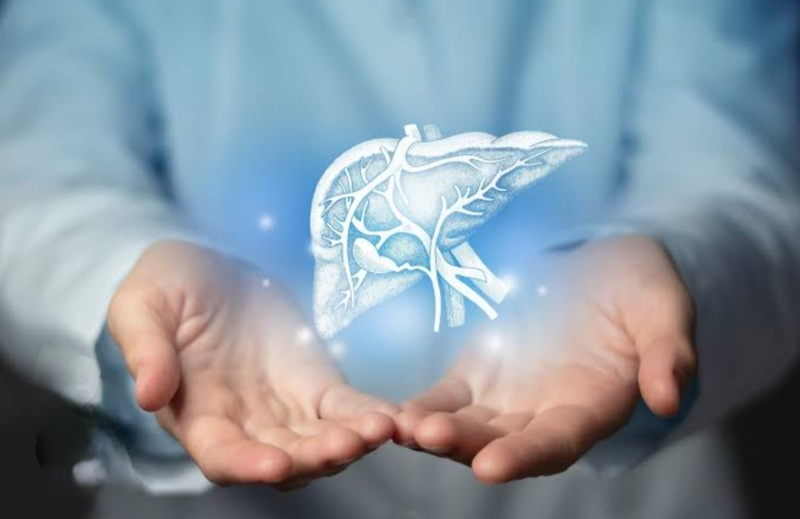
Revolutionizing liver:
The field of liver health is undergoing rapid advancements, with technologies like 3D organoids, AI, and machine learning poised to revolutionize diagnosis, treatment, and even organ regeneration. These innovations offer the potential for more precise and personalized care for liver diseases.
Key advancements include:
3D Organoid Technology:
Mimicking the human liver's environment, 3D organoids are providing new insights into liver fibrosis and potential therapies. These models offer a more accurate representation of liver function compared to traditional cell cultures, allowing researchers to study disease mechanisms and test potential treatments more effectively.
AI and Machine Learning:
AI is being used to improve the accuracy and efficiency of liver disease diagnosis

Slide 9
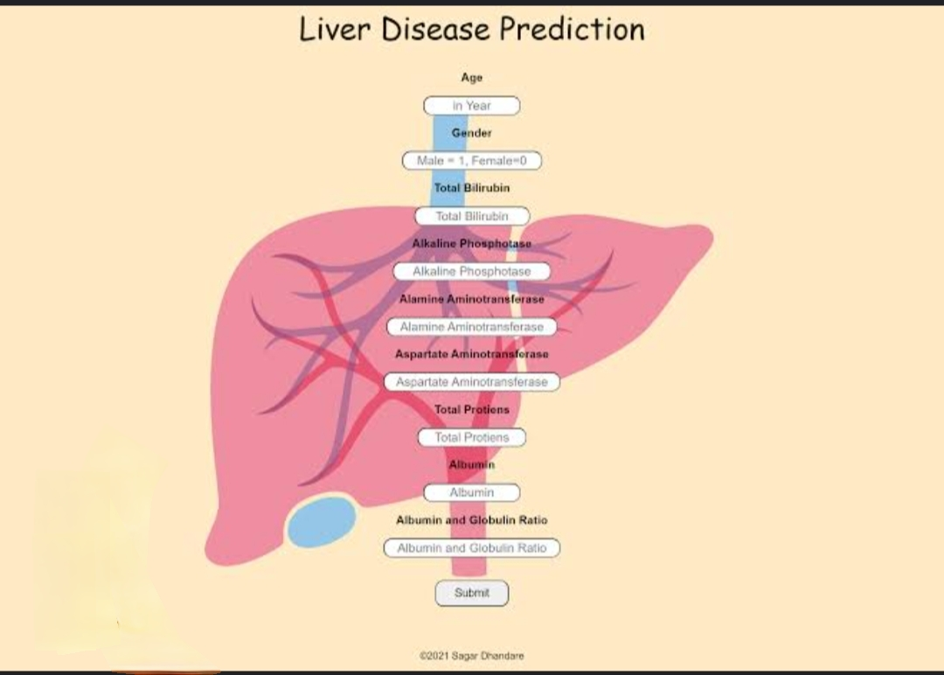
Predicting Liver Cirrhosis Using Advanced Machine Learning Techniques :
Algorithms like decision trees, random forests, and support vector machines, along with neural networks, can analyze patient data to identify patterns and predict the likelihood of developing cirrhosis. These models can be trained using various datasets including clinical, biochemical, and demographic information. Feature selection methods are employed to identify the most relevant predictors, improving model accuracy and interpretability.
Here's a more detailed look:
1. Data Sources:
Clinical Data: Patient history, symptoms, and physical examination findings.
Biochemical Data: Blood tests, including liver function tests (LFTs) and other relevant markers.
Demographic Data: Age, sex, ethnicity, and other relevant demographic

Slide 10
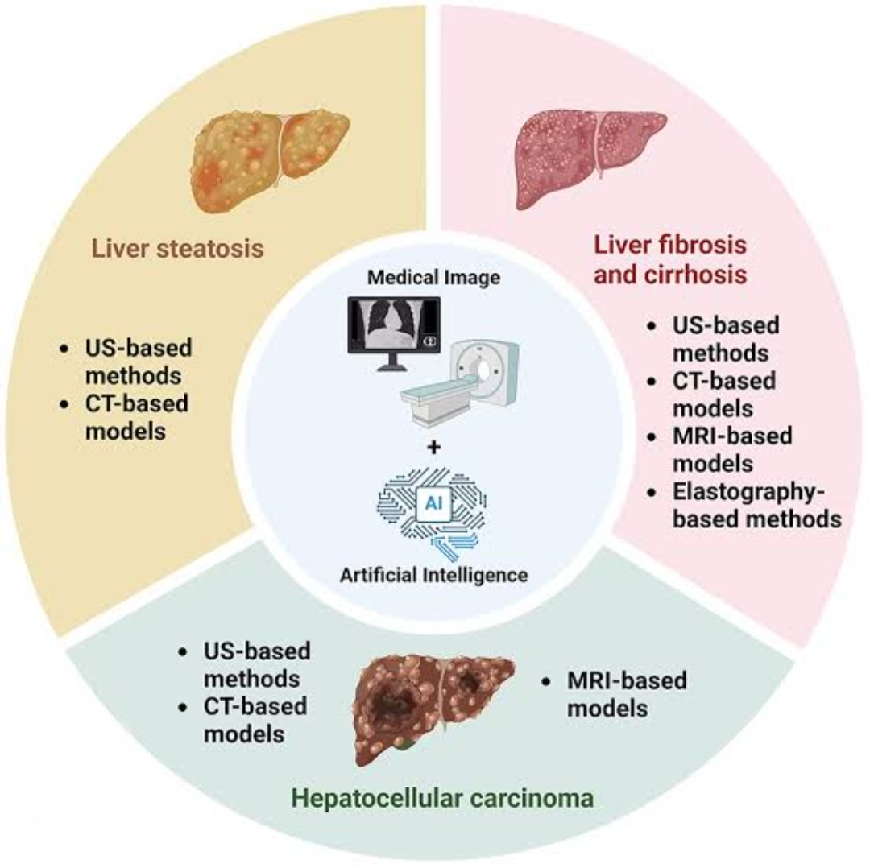
CONCLUSION :
Machine learning is revolutionizing liver care by enabling earlier and more accurate prediction of liver cirrhosis using advanced algorithms and medical datasets. This approach can significantly improve patient outcomes by facilitating timely interventions and personalized treatment plans. Ensemble models and feature selection techniques further enhance the robustness and interpretability of these predictive models.

Slide 11


